Slide 1
Applied Data Science Capstone
By Marcos Ramirez

Slide 2
Introduction
Applied Data Science Capstone
Introduction/Business Problem
To predict Severity of an accident
This is the final Capstone Project in the IBM Certificate. I will analyse Severity of an accident and correlation with attributes like weather condition, road condition and light conditions. I have two severities 1= Property Damage Only Collision and 2= Injury Collision.
Predictive model could warn us, about the possibility of you getting into a car accident and how severe it would be, so that you would drive more carefully or even change your travel if you are able to.

Slide 3
Data
About the dataset
I will use a Data-Collision dataset for predicting severity of an accident. This is a historical collision dataset where each row represents one collision. The data is relatively easy to understand.
This data set provides information to help you predict what element could be important to avoid accidents.
The dataset includes information about:
Accidents happened since 2004 in Seattle city.
The dataset has 37 attributes and 194,673 records. this a supervised data.
CVS file "Data-Collisions" for the data analysis portion of this project, Github was used for a repository and I chose to use Jupiter Notebook.
I will use Python libraries throughout the analysis like Pandas, Numpy, Matplotlib, scipy.optimize, sklearn, matplotlib and Seaborn.

Slide 4
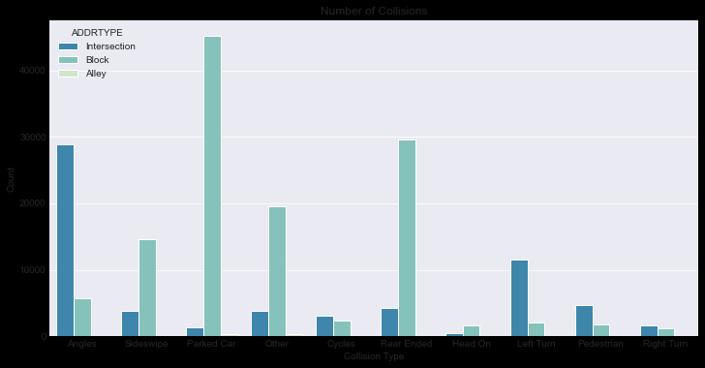
Metodology
Load the dataset into Jupyter Notebook
Clean the dataset
Removing unnecessary columns and continuo with ADDRTYPE, WEATHER, ROADCOND and LIGHTCOND

Slide 5
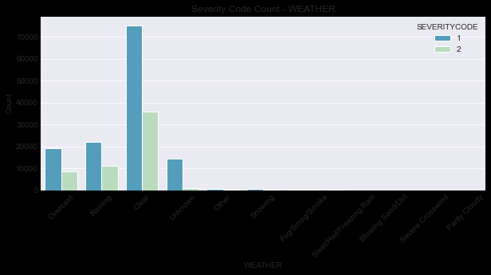
Metodology

Slide 6
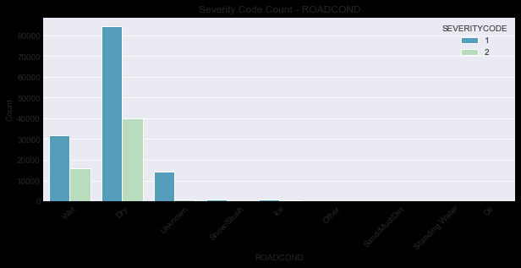
Metodology

Slide 7
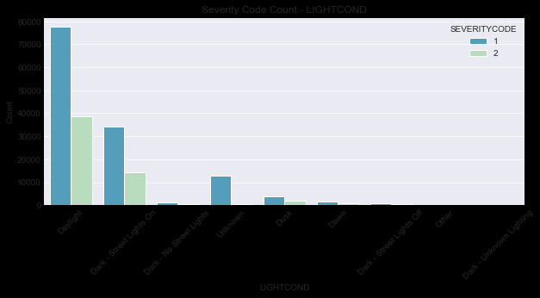
Metodology

Slide 8
Metodology
Continue with Dataset Cleaning
Drop Records. Removing records like “Unknown” , missing
Normalization. Convert data to 0 or 1 to build the model
One Hot Econding. Convert text to binary integer.

Slide 9
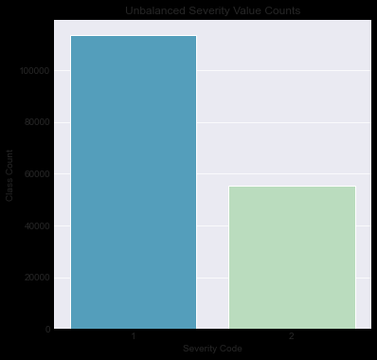
Metodology
Continue with Dataset Cleaning
The Dataset is unbalanced. I have more records of SEVERITYCODE =1 than SEVERITYCODE=2

Slide 10
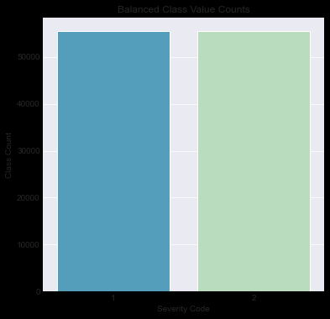
Metodology
Continue with Dataset Cleaning
I used the method of under sampling to balance the dataset

Slide 11
Metodology
Modeling
Data Selection. Defined the independent and dependent variables
Make the split for Training and Testing set. I use 80% for training set vs. 20% testing set.
Train Model. I decided to logistic regression model with the training dataset
Evaluate and measuring accuracy. I use methods like F1-Score, Jaccard score and LogLoss. I looking for maximum accuracy.

Slide 12
Result
Conclusion
I can say that the model is accurate 0.64 for severity 1 and 0.41 for severity 2.
The weighted average F1-Score is 0.52 that I concluded the predictor variable s that we defined are likely inconsequential in predicting the severity code
precision recall f1-score support
1 0.53 0.80 0.64 11083
2 0.60 0.31 0.41 11133
accuracy 0.55 22216
macro avg 0.57 0.55 0.52 22216
weighted avg 0.57 0.55 0.52 22216

Slide 13
Result
precision recall f1-score support 1 0.53 0.80 0.64 11083 2 0.60 0.31 0.41 11133 accuracy 0.55 22216 macro avg 0.57 0.55 0.52 22216 weighted avg 0.57 0.55 0.52 22216
Conclusion
A significant number of factors may determine if a collision occurs and whether or not property is damaged or persons are injured.
The objective of this report was to identify if any such factors are accurately able to predict the severity of an accident. Severity was classified as a 1 if only property was damaged or as a 2 if injuries occurred as well. After preparing, cleaning, and balancing the dataset, a logistic regression model was built to predict the severity code. The dataset was split into 80% for training and 20% for training, in order to improve the out of sample accuracy.
The model itself was able to somewhat accurately predict the class value of 1 but was not very effective at accurately predicting the class value of 2. The results of the analysis determined that the identified factors are not significant indicators of the severity code measurement.

